Slide 1


Natural Language Processing
Semantic Plagiarism Detection for Academic Paper
Team Members:
123B1F012 - Rutuja Bobade
123B1F057 - Sankarshan Mahamuni
Guided By:-
Dr. Harsha Bhute

Slide 2


Introduction
Natural Language Processing (NLP) is a field of Artificial Intelligence that enables computers to understand, interpret, and process human language.
NLP has many real-world applications such as machine translation, chatbots, sentiment analysis, information retrieval, and plagiarism detection.
In academic and research environments, plagiarism detection is important to maintain originality and academic integrity.

Slide 3


Problem Statement
Traditional plagiarism detection systems rely mainly on lexical similarity techniques such as TF-IDF and keyword matching.
These methods work well for exact text copying, but they fail to detect semantic plagiarism.
In semantic plagiarism, the meaning of the content remains the same while the wording is changed through paraphrasing, synonym replacement, or sentence restructuring.
With the increasing use of AI writing and paraphrasing tools, detecting such plagiarism has become more challenging.

Slide 4



Motivation
The rapid growth of digital research papers and online resources has increased the risk of plagiarism in academic writing.
Modern tools such as AI writing assistants and paraphrasing tools allow users to easily rewrite content while keeping the same meaning.
Traditional plagiarism detection systems mainly focus on exact word matching, making them ineffective against paraphrased or meaning-preserving plagiarism.
Detecting such semantic plagiarism is essential to maintain academic integrity and research originality.
This motivates the development of a semantic plagiarism detection system using advanced NLP techniques such as TF-IDF and Sentence-BERT.

Slide 5
Objective
01
To develop a semantic plagiarism detection system for research papers using a hybrid approach combining TF-IDF and Sentence-BERT.
02
To detect paraphrased and meaning-preserving plagiarism by analyzing both lexical and contextual similarity.
03
To generate explainable plagiarism reports by identifying similar sections and sentences in academic documents.

Slide 6
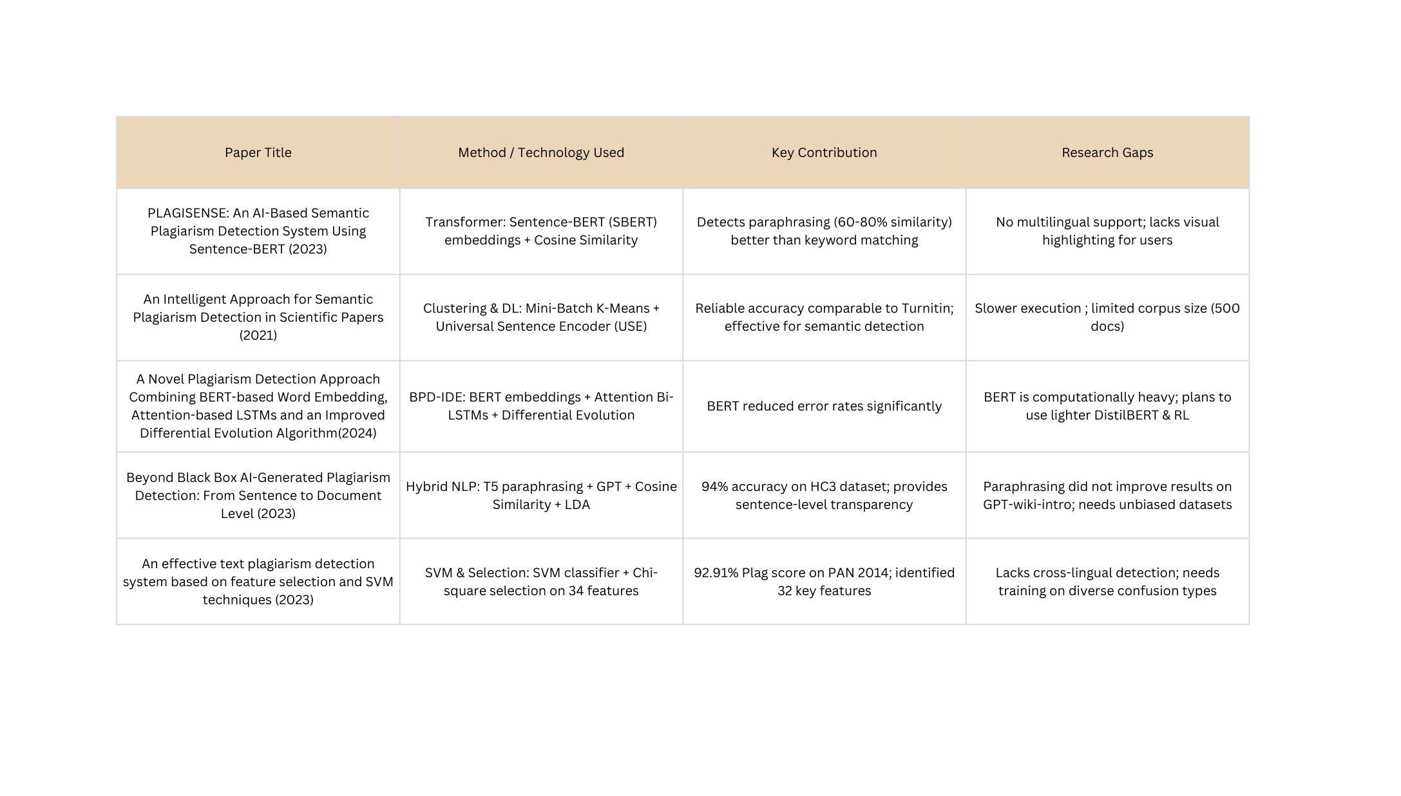
Literature Survey

Slide 7

Methodology
Dataset
Frameworks
Text Preprocessing
Research Paper are collected from open access academic repositories including -
IEEE Xplore - engineering and computing journals
ACM Digital Library - computer science and journal papers
arXiv - widely used for CS preprints
Lowercasing - Normalizing the text to remove ambiguity among capital and lowercase words.
Tokenization - Splitting of texts into words.
Stopword removal - Removal of words which don't change the semantic meaning.
Lemmatization - Convert the words into their base form.
Noise Removal - Removal of references and the equations in the paper.
TF-IDF : Checks Lexical similarity among the research papers
Sentence Bert: Checks Contextual similarity using embedding generated (Built on BERT)
FAISS for efficient retrieval of embeddings stored by sentence bert.
~500-600 research paper focusing on the domains of data science , AI, ML software engineering, and other computer science related fields.

Slide 8

Feature Representation (TF-IDF)
Step 1 : Text Preprocessing and Tokenization
Step 4: Vector Representation
Step 2: Term Frequency Calcualtion
Each document is converted into a numerical vector where every value represents the TF-IDF score of a word from the vocabulary.
TF(t,d)= Total number of terms in document t
Number of occurrences of term d
Step 3: Inverse Document Frequency (IDF)
Calculation
Step 5: Similarity Calculation
Step 4: TF-IDF Score Computation
TF-IDF(t,d)=TF(t,d)×IDF(t)

Slide 9
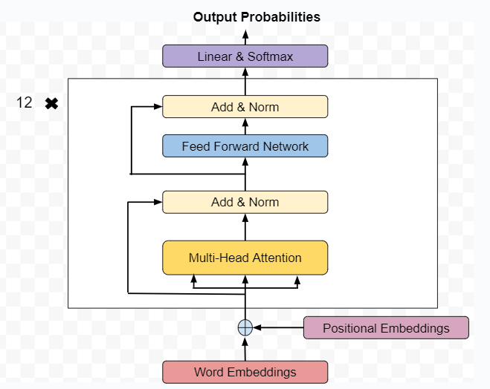
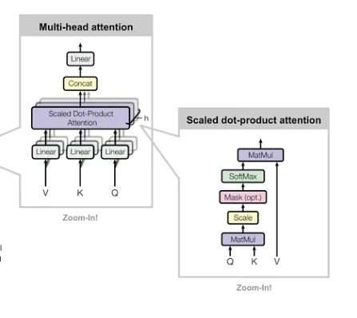
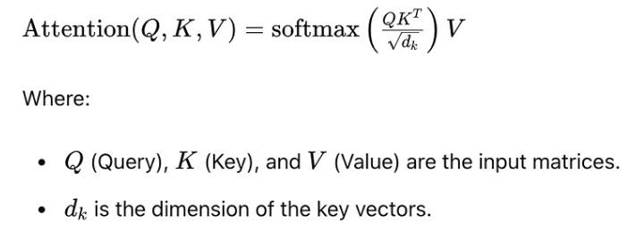
BERT Architecture

Slide 10
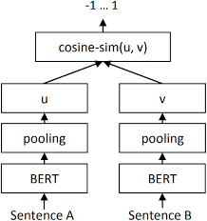
SBERT Architecture
BERT produces embeddings for each token (word), not for the entire sentence.
Pooling combines multiple token vectors into a single sentence vector.

Slide 11
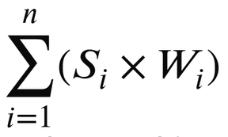
Section Weighted Similarity Scoring
Different research paper sections vary in originality requirements. Predefined weights emphasize critical sections like methodology and results, which should have higher uniqueness
Abstract | Introduction | Methodology | Conclusion | Results
15% | 15% | 35% | 10% | 25%
Overall Plagiarism =

Slide 12
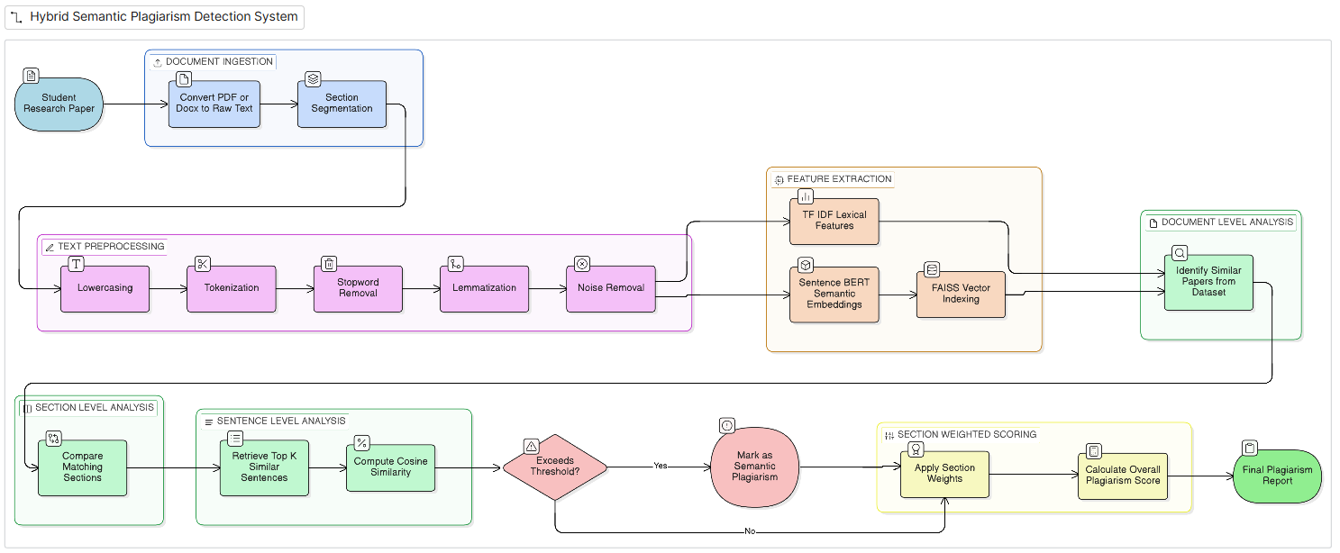
System Flow Diagram

Slide 13
Conclusion & Key Contribution
This work proposes a hybrid hierarchical framework for semantic plagiarism detection in academic computer science papers by combining lexical and semantic similarity techniques.
Hierarchical Analysis
Hybrid Framework
Scalable Retrieval
Document, Section, sentence-level evaluation for precise localization
Integrates TF-IDF with Sentence-Bert embeddings
FAISS-based indexing fpr fast similarity search

Slide 14
THANK YOU!

